Slide 1
Moon and Cake : MailSend System
Member:
CEEN, Chun-Sheng Wu
CEEN, Yao-Wen Chang
CSCE, Ya-Ru Yang
CSCE, Yi-Chia Wu
CEEN, Tung-Chi Yeh
Yi-Chia Wu

Slide 2
Outline
Project Introduction
User Stories
Main Features Introduction
Goal: Manage & send email draft
Different home Page UI: executive-end/assistant-end
Challenges and Lessons
Demo
Related links

Slide 3
Project Introduction

Slide 4
Project Introduction
MailSend system is accordingly designed to help the executive compose, arrange, and send the mails they need to deal with.
Executive-end: assigning tasks, reviewing the drafts before sending
Assistant-end: assisting the executive (professor) with email contents

Slide 5
User Stories

Slide 6
User Stories
Login via Google API and Self-Registration
Login role (executive/assistant) chosen by user
Database
Constructed for storing user data, drafts, and email linkage information
Platform Integration and Deployment
Exist platform integration between ReactJS, Django, and Firebase
Mail Sending
In order to deal with the task of sending mails
Interface Design
Classify two different roles with colors, homepage, display on the top, and sidebar
Draft Workflow
The executives assign the drafting task to an assistant with deadline involved
Option: accept&send, reject, delete
The assistants complete the draft and send back to the executive for review

Slide 7
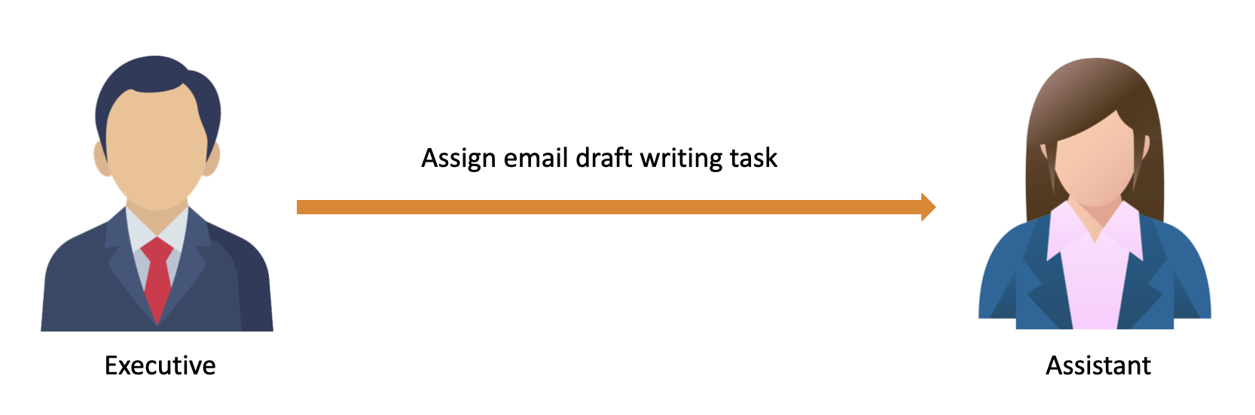
Project Introduction

Slide 8
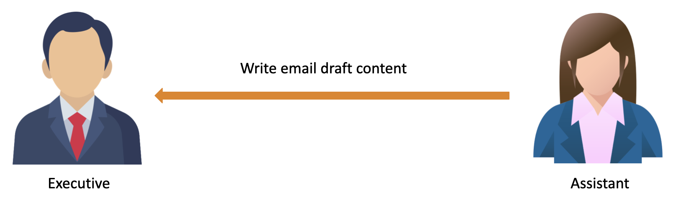
Project Introduction

Slide 9
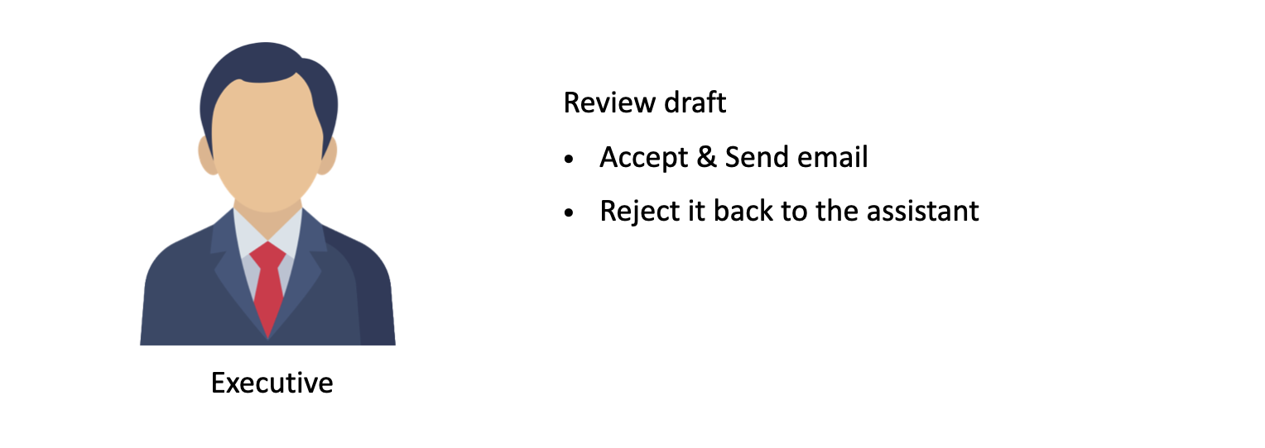
Project Introduction

Slide 10
Main Features Introduction

Slide 11
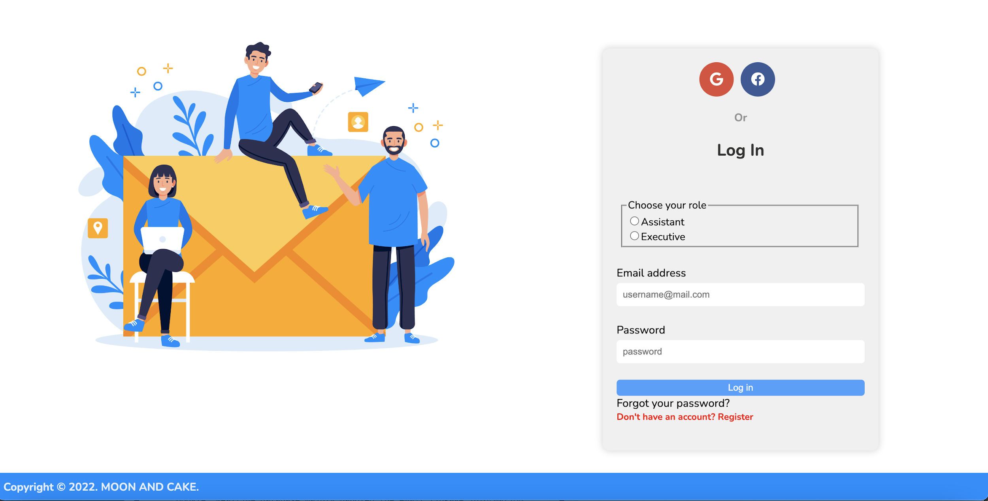
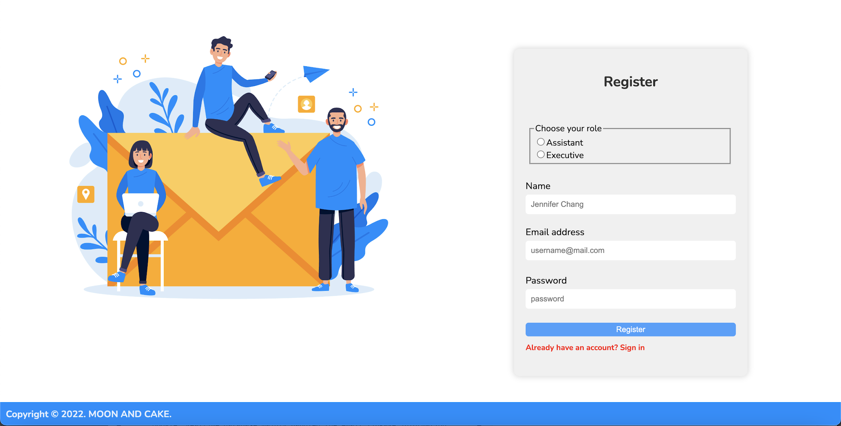
Main Features Introduction
Landing page: register/login feature
Login form
Register form

Slide 12
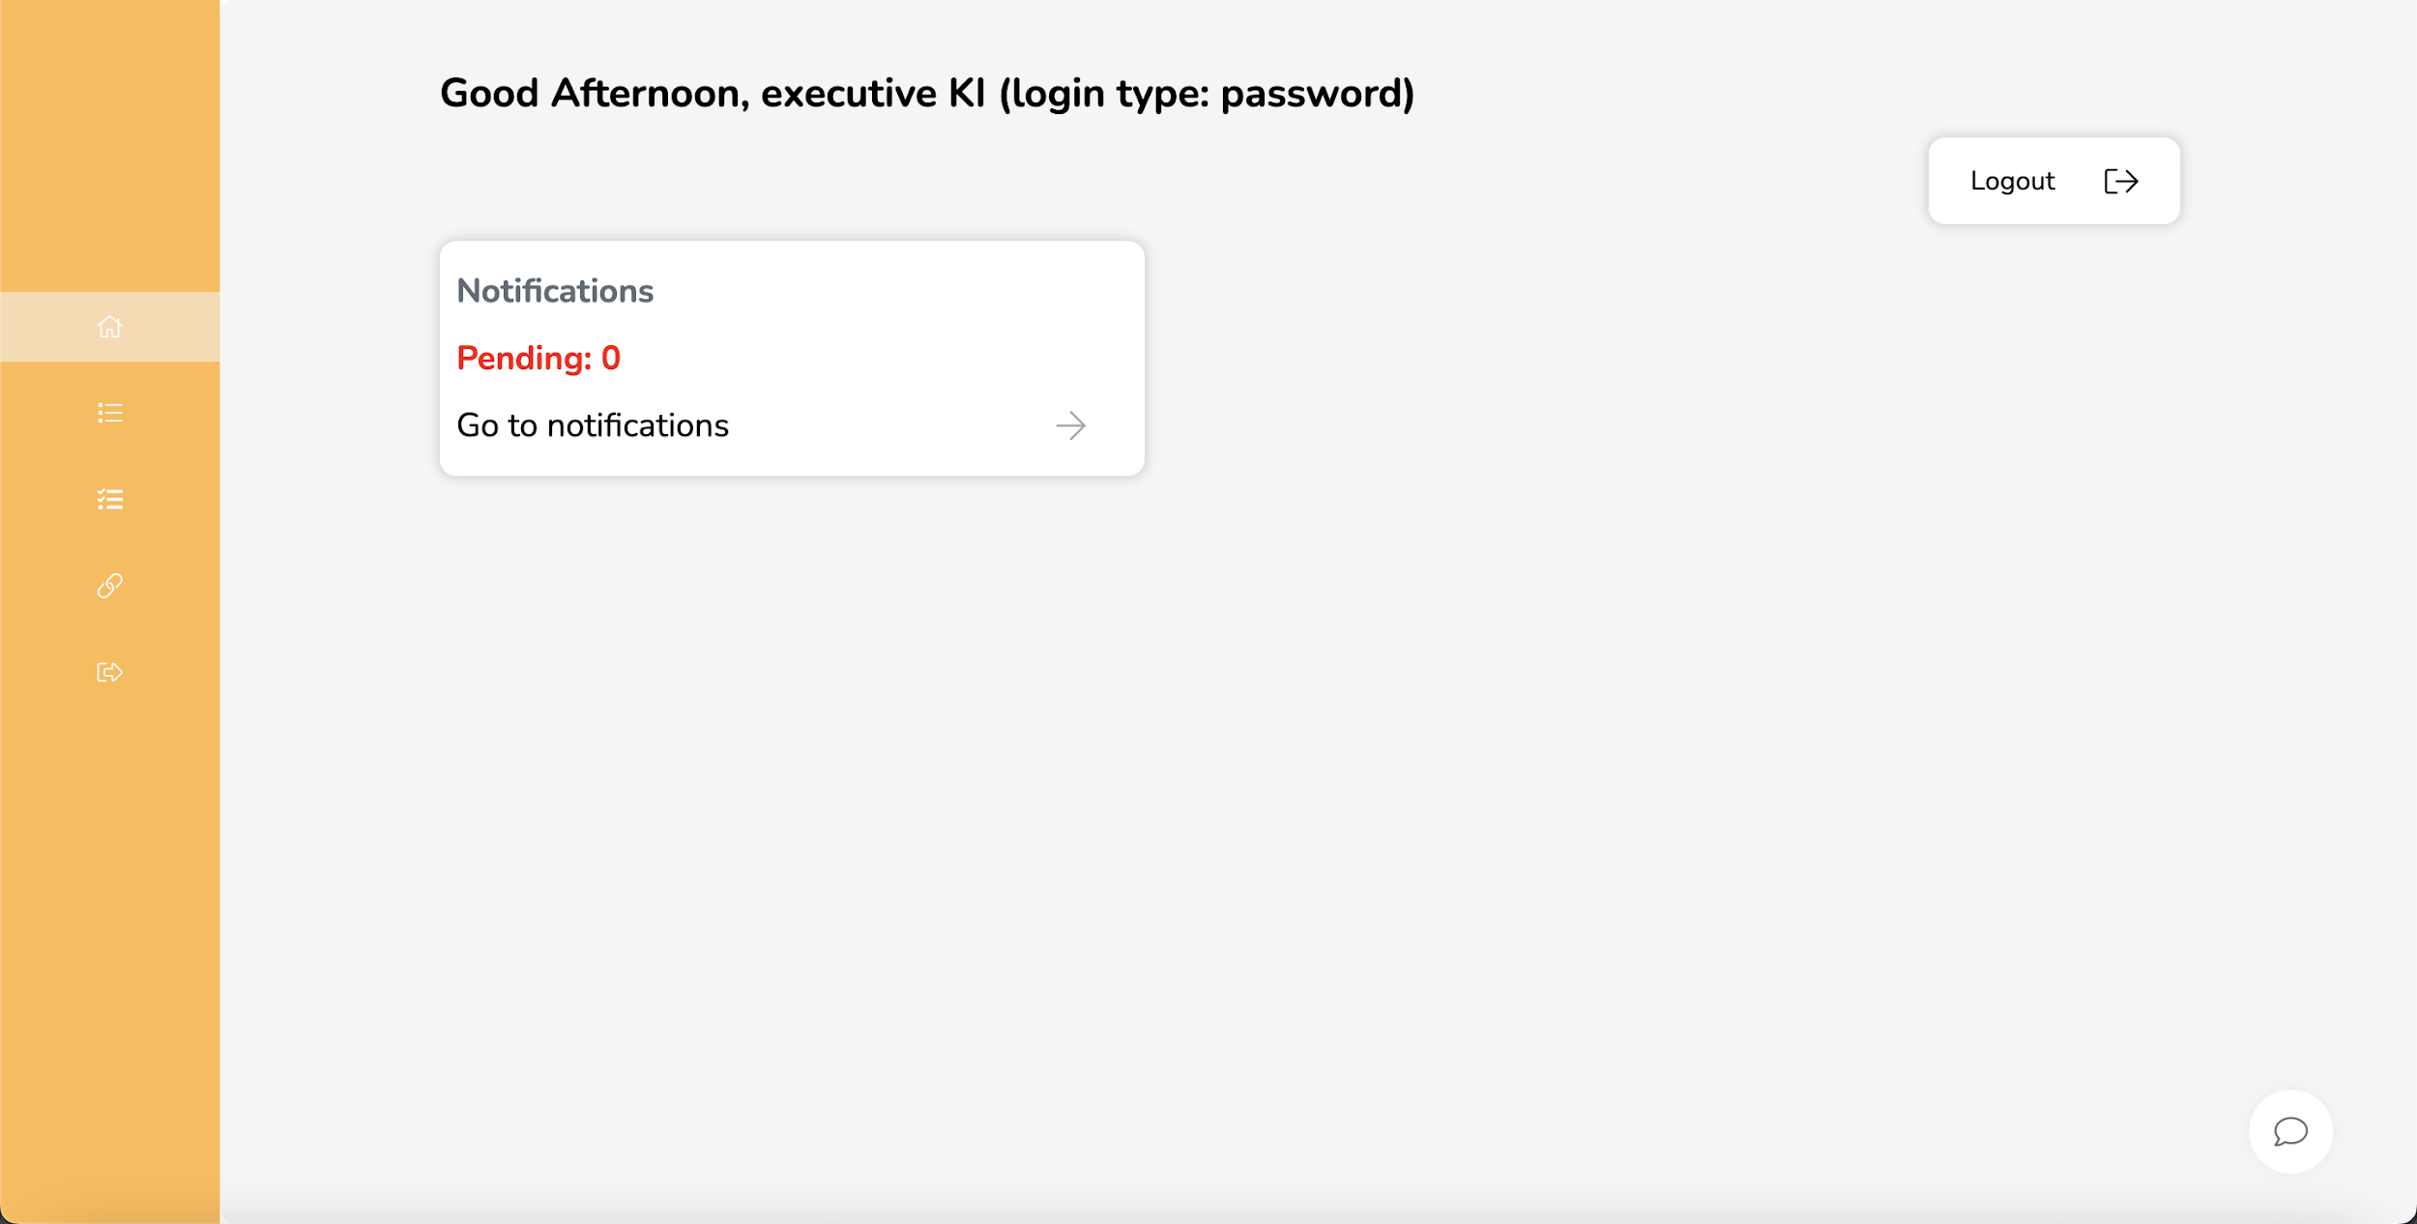
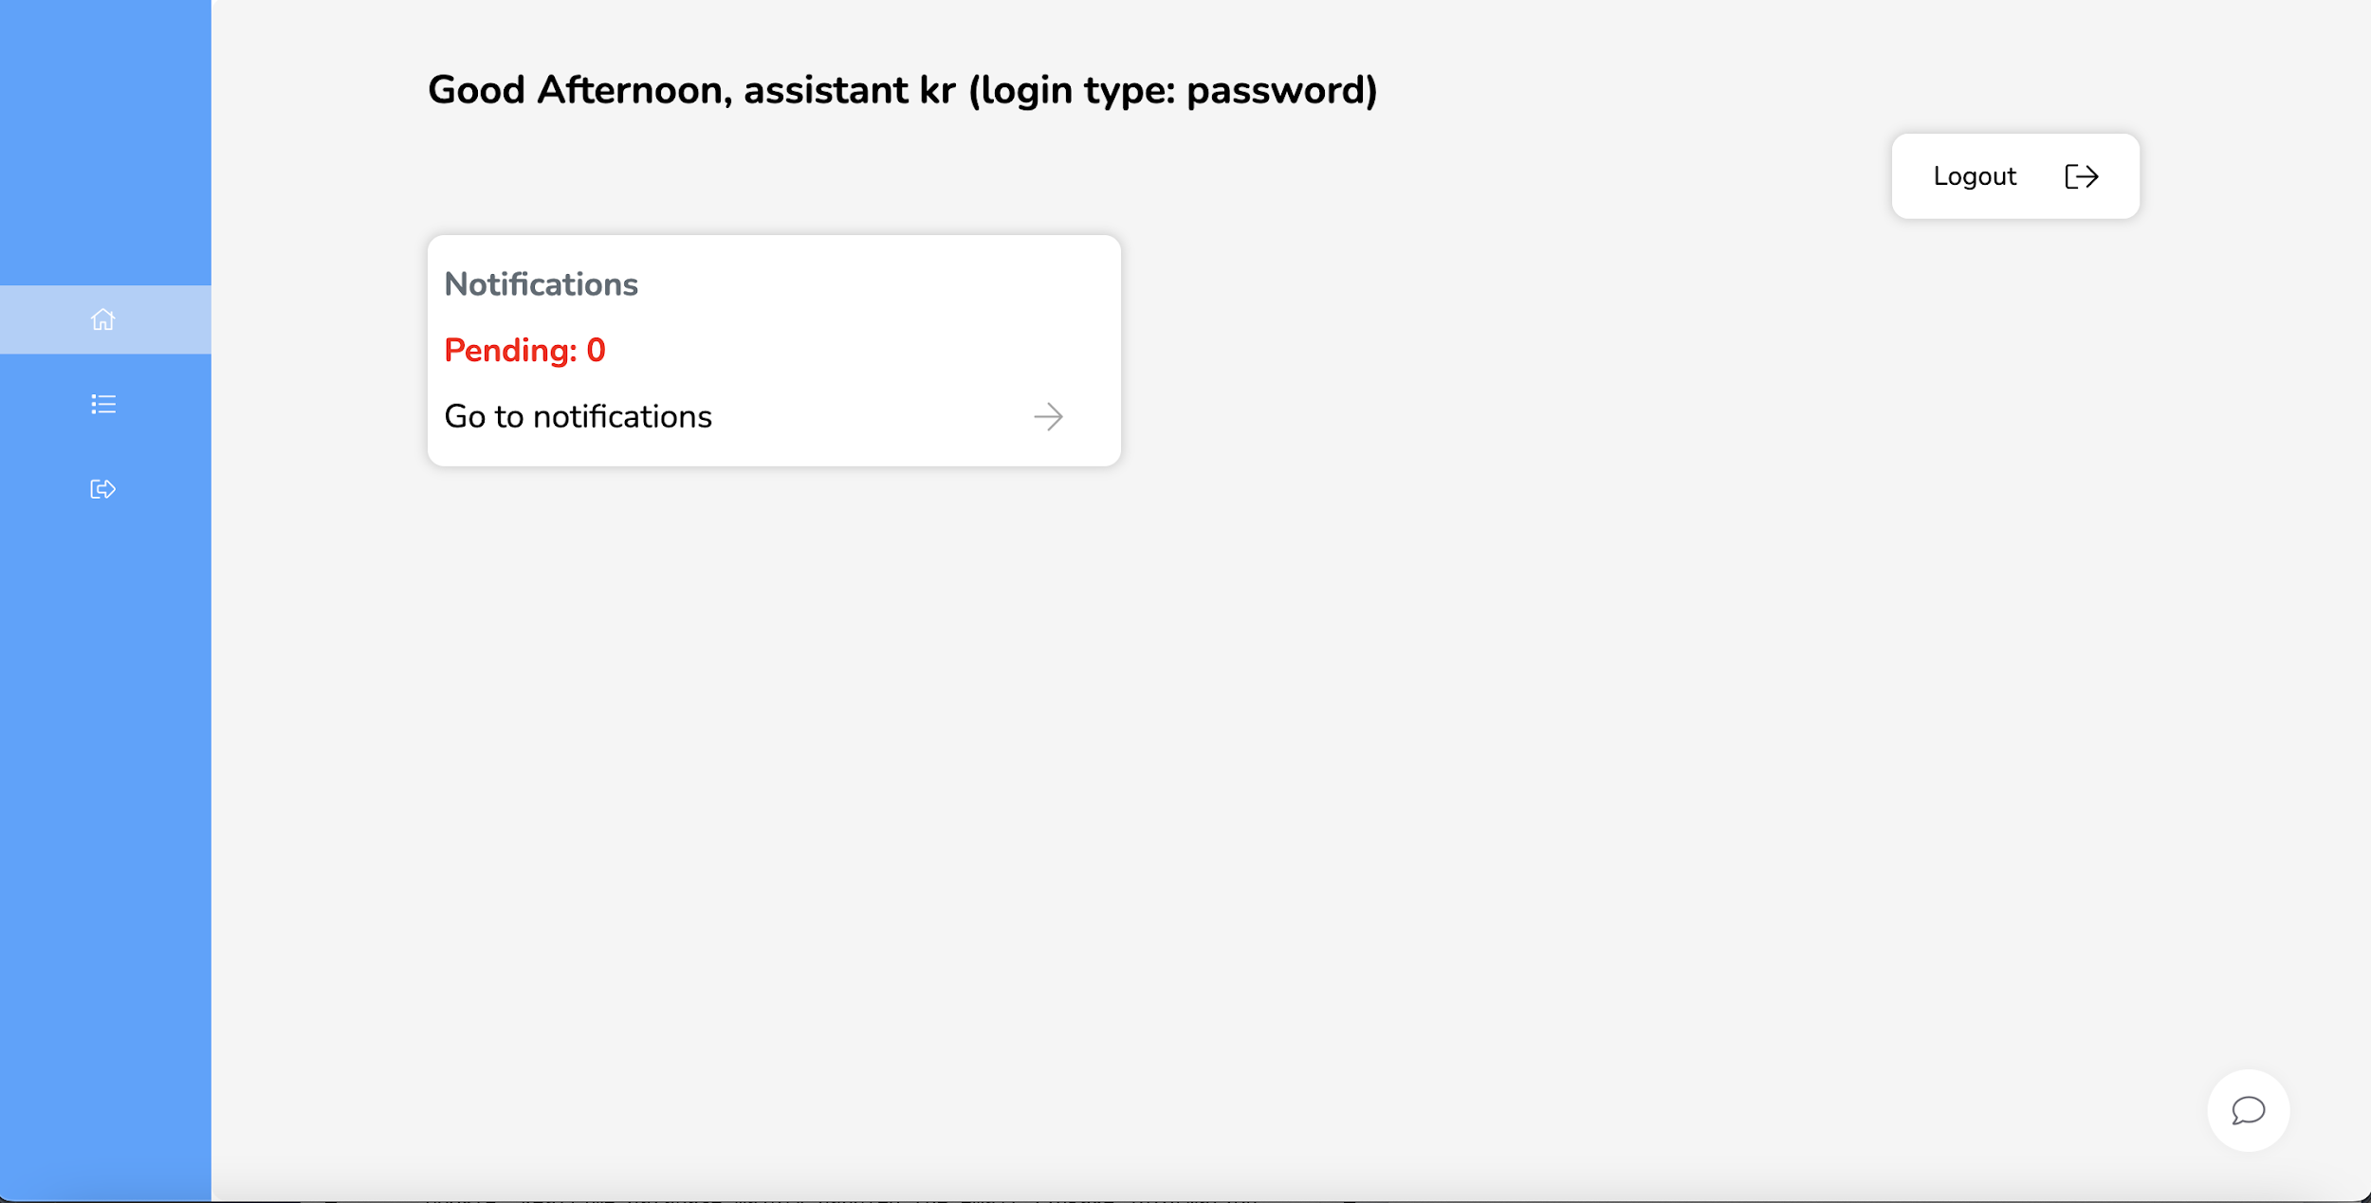
Main Features Introduction
Home page: different UI by different role
Executive-end notification window
Assistant-end notification window

Slide 13
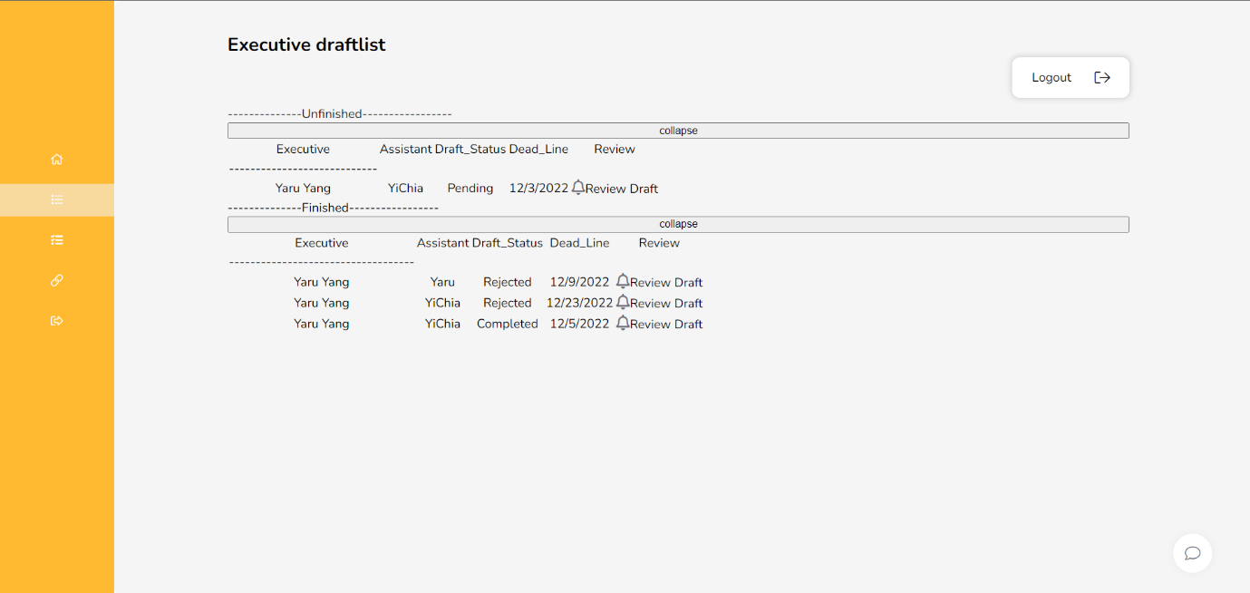
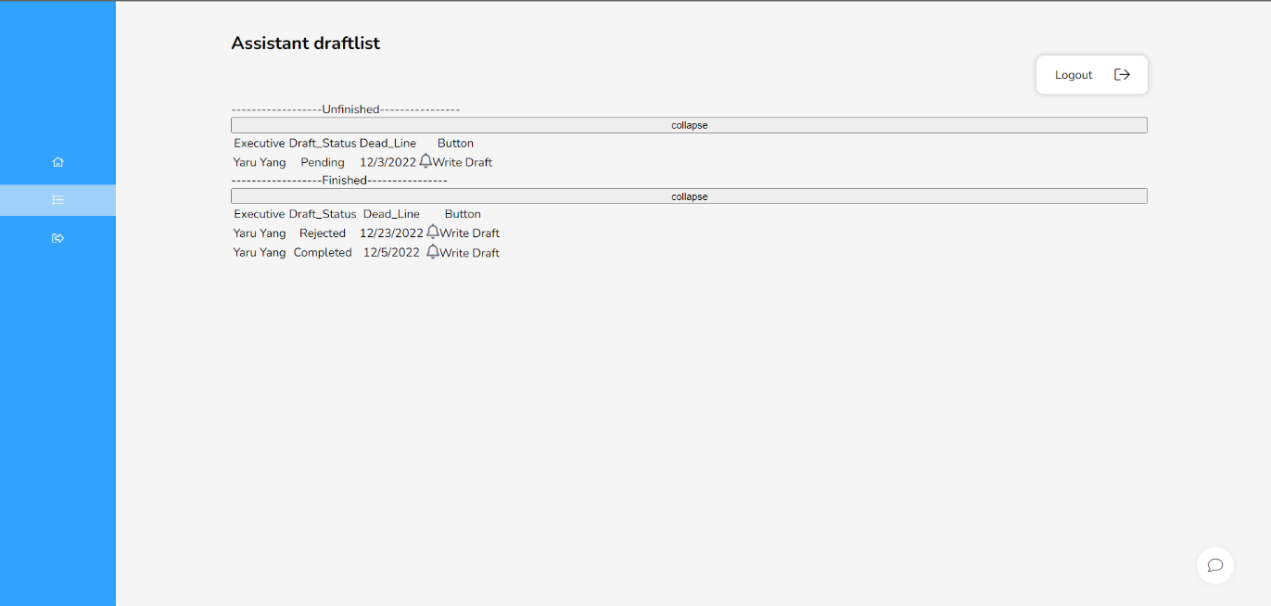
Main Features Introduction
Email draftlist page
Executive draftlist
Assistant draftlist

Slide 14
Challenges and lessons

Slide 15
Challenges and Lessons
Platform Integration between ReactJS, Django, and Firebase
Login via different API
Deal with Git issues
Push to Heroku issues
Fit the interface to different user’s screen
Improve user experience
Learn ReactJS and debug
Import EmailJS to our application

Slide 16
Demo

Slide 17
Related Links

Slide 18
Related Links
Pivotal Tracker: https://www.pivotaltracker.com/n/projects/2596847
Github Repo: https://github.com/yehtungchi336-tamu/MIRC-Code-Verification
Heroku: http://react-login-home.herokuapp.com

Slide 19
Thank you !
Notes:
Thank you for watching our presentation!

